Slide 1

HCI - Assignment n.2
Design and prototyping of an application using a human-centered approach
Final presentation and demo
Project Title: Personal Finance Management App
Group: Jodionísio Muachifi «97147», João Felisberto «98003» & Diogo Santos «98393»
Lab Class: P4
09-06-2022
HCI 2021-2022

Slide 2
Introduction
Personal Finance Management App
Personal finance is important for everyone and it was never easy to manage.
Personal finance is specific to an individual’s situation and activity. Therefore, financial strategies depend largely on the person’s earnings, living requirements, goals and desires.
The purpose of our app is to help people that have little financial literacy manage their money.
We intend to develop a user-friendly personal finance management app.
HCI 2021-2022
2
Notes:
These first slides are a recap of the first presentation and should be presented without much detail

Slide 3
Project Objectives
Personal Finance Management App
High-level goals
Develop an App that permits users to manage their finances in a simple way.
Allow users to plan their budgets and savings, according to their goals.
Let users strongly control their daily expenses.
Expected outcomes
We aim for a semi-functional application with a minimalist and intuitive interface.
We achieved it as expected!
The benefits
Provide an easy way for users to organize their budgets and savings for their goals.
HCI 2021-2022
3

Slide 4
Personas
Personal Finance Management App
Target Users
People that have little literacy on finance
People with poor money management
HCI 2021-2022
4

Slide 5

Persona 1
Personal Finance Management App
Persona | Scholarship holder
Name, Age, Gender | Ana Bela, 22 y/o, Female
Job | Student at Aveiro University
Background/Environment | She wants to control her daily expenses She wants to save money for her holiday voyage
Needs | She wants an app to help her easily manage her finances
HCI 2021-2022
5

Slide 6
Scenarios
Personal Finance Management App
Ana Bela orders a cup of coffee and wants to register the expense.
Ana Bela's rent goes up, so she needs to readjust the budget
Ana Bela checks how much more money she needs to save for her summer vacation
Ana Bela registers her savings
HCI 2021-2022
6

Slide 7
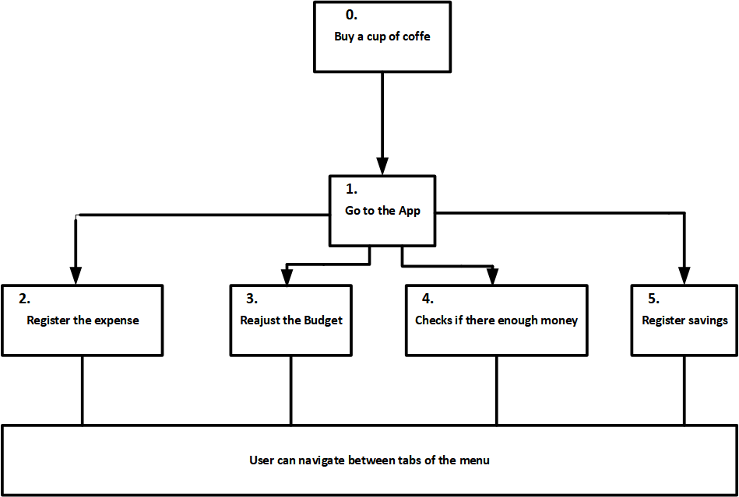
Tasks
Personal Finance Management App
# for scenario 1
HCI 2021-2022
7

Slide 8
Requirements
Personal Finance Management App
Non-functional requirements
Should be easy and practical to use
Mobile
Persistent
Individual
Functional Requirements
Register expenses associated with category
Create, modify and delete categories
Create, modify and delete saving goals
View expenses, budgets and goals
View how much money of each budget was spent
View how much money was already saved for each goal
Add money to a goal
HCI 2021-2022
8

Slide 9
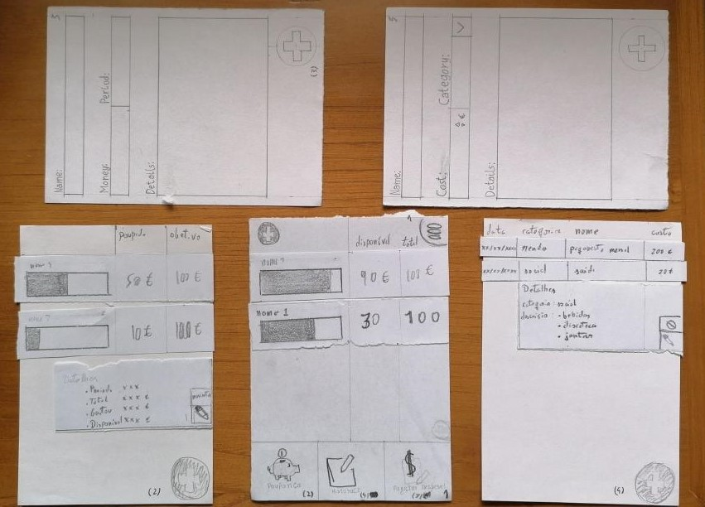
Low Fidelity Prototype (LFP)
Personal Finance Management App
The low fidelity prototype was
developed in paper
We tested it by having potential
users realizing tasks in our app: our classmates
HCI 2021-2022
9
Notes:
This is new material; should be presented in more detail

Slide 10
LFP User Evaluation
Personal Finance Management App
Usability test with paper prototype
Evaluation of the user interface: how intuitive is it and is it easy and quick to execute the given tasks
3 tasks (registering an expense, observing a budget and editing a saving)
Users: classmates
User feedback
Buttons on top to go back
Button to more quickly add a budget/expense
Pie chart and graphs for better visualization
Icons were not very explicit and lacked labels
HCI 2021-2022
10

Slide 11


Platform Used for the functional prototype
Personal Finance Management App
The main tool used was Android Studio
Chosen because it made more sense for this app
HCI 2021-2022
11

Slide 12
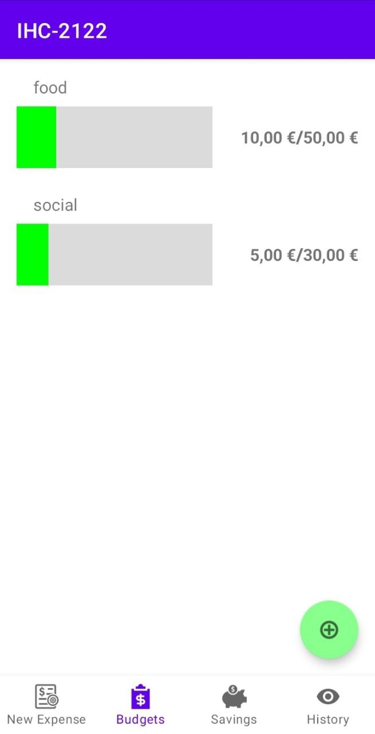
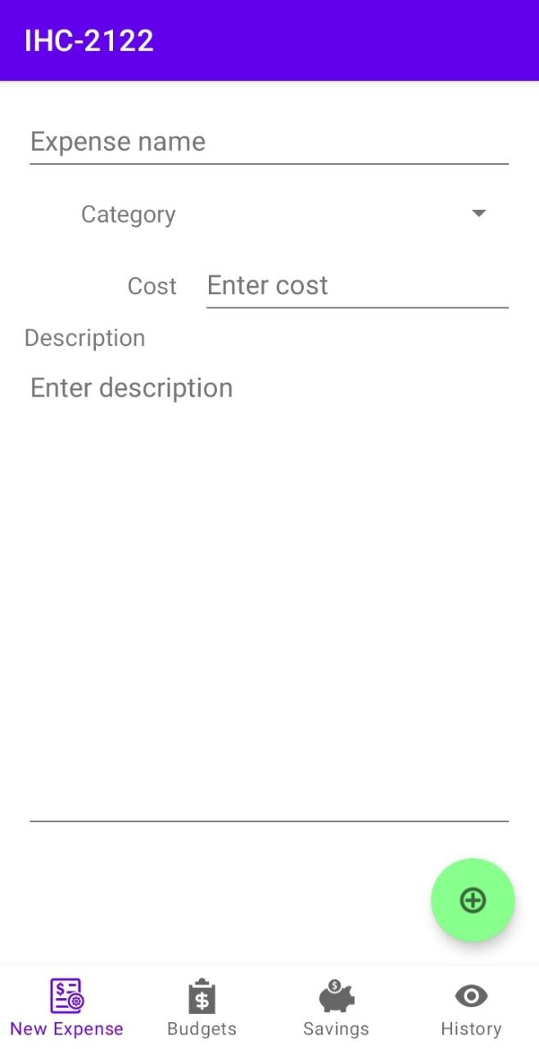
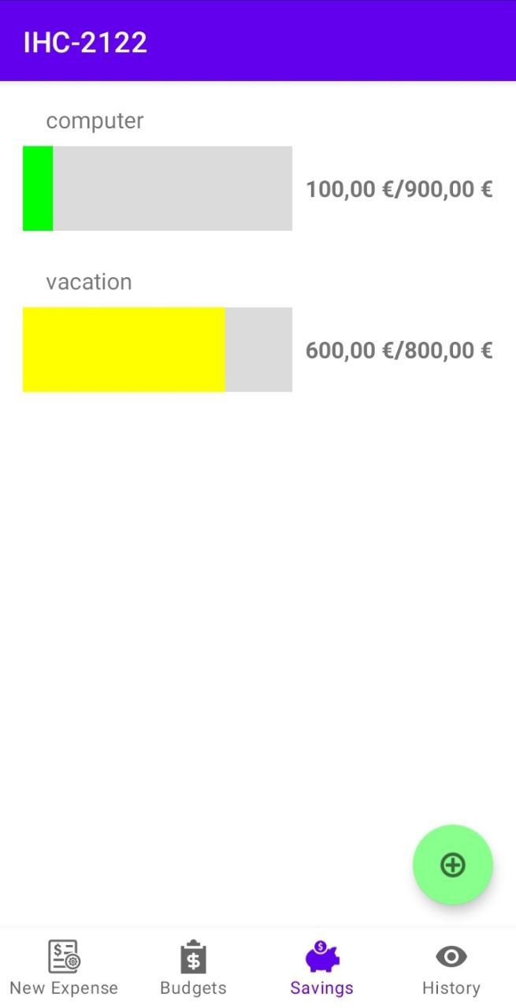
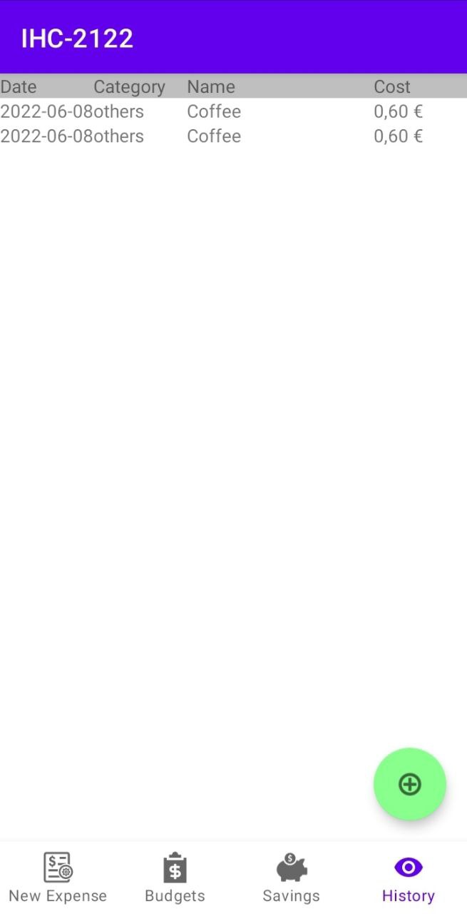
User Evaluation of the functional prototype
Usability test with prototype running in a mobile device
Used to validate our UI and get feedback on design choices
5 tasks (register expense, check budget, create budget for a service, view savings and edit savings)
Classmates, at least 1 of each practical group and class teacher
1 female 5 males
20.4 years average (19-24)
2/5 had no experience with such apps, 1/5 had a lot of experience
Observer script/guide based on the ones used in a practical class, as well as post-task questionnaires (SUS)
HCI 2021-2022
12

Slide 13
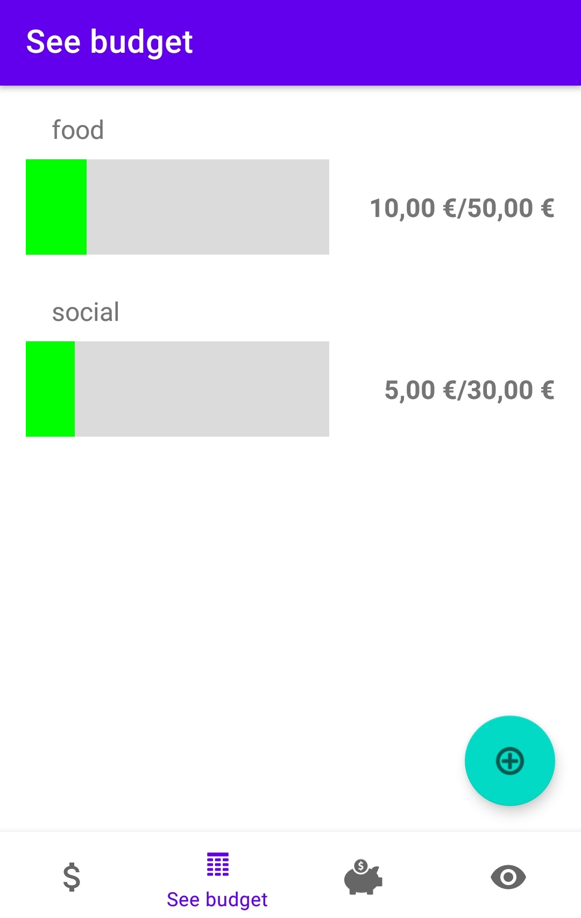
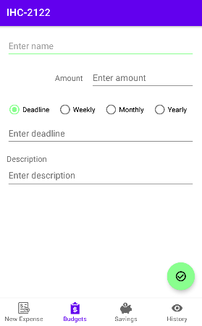
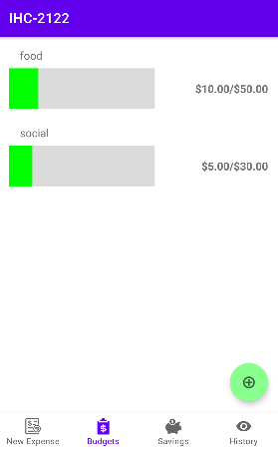
User Evaluation of the functional prototype
Changes made
Labels changed on the bottom and now always showing
Budgets and New expenses have updated icons
"Add" button color changed to light green
Weekly, monthly and yearly budgets/savings
"Deadline" instead of "Date"
"Check" icon when editing something
Fixed navigation between pages
HCI 2021-2022
13

Slide 14
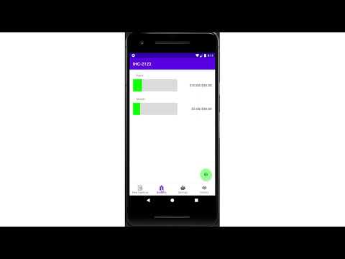
Demo
Personal Finance Management App
Small demo of the execution of the 5 tasks
HCI 2021-2022
14

Slide 15
Future work
More graphs and better data visualization
Maybe improve frontend based on user feedback
Add new functionalities like backup
In general fix the persistent backend if we deploy it to production
Effort of each group member
Jodionísio Muachifi – 33%
Diogo Santos – 33%
João Felisberto – 33%
HCI 2021-2022
15

Slide 16
Acknowledgments
To all participants that participated on the two tests of our low fidelity prototype and of the functional prototype.
Bibliography
Cooper, A., R. Reimann, and D. Cronin, About Face 3 The Essentials of Interaction Design. Wiley Publishing, Inc., 2007
HCI 2021-2022
16

